Slide 1

Bluetooth Tracking for Activity Recognition
Amanda Watson
Advanced Computer Networking

Slide 2
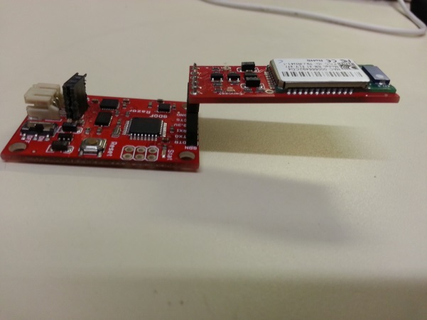
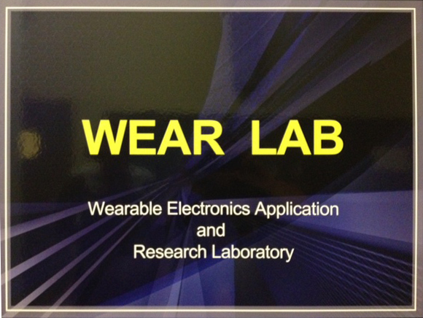
Problem
Activity Recognition is increasing in popularity and applications. Most commercial trackers use an accelerometer and require a communication device to sync data. By removing the accelerometer we can decrease the size of the device thus making it more comfortable to wear.

Slide 3

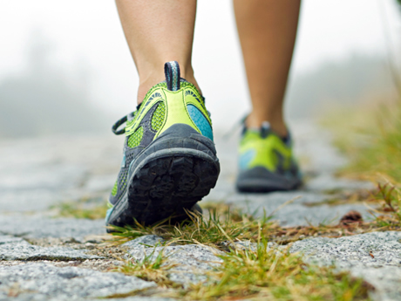
Problem
When using an accelerometer, the data is not always accurate. For example clapping can be interpreted as steps.

Slide 4
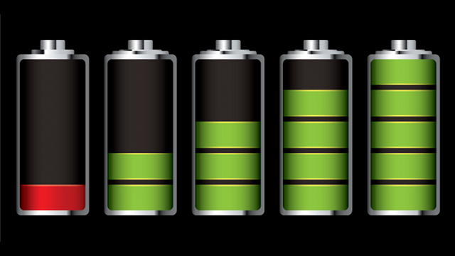
Research Questions
Using only Bluetooth, is it possible to monitor activity accurately, regardless of disconnections?
Will being continuously connected through Bluetooth drain the battery of the master Bluetooth device or the slave Bluetooth devices to the extent that it is no longer feasible to use it for activity monitoring?

Slide 5
Related Work
An activity monitoring system has been implemented using the Zigbee protocol, RadioSense: Exploiting Wireless Communication Patterns for Body Sensor Network Activity Recognition.
  Zigbee is not generally used in commercial products, while Bluetooth is.
  Bluetooth devices are already in use and can be used for activity recognition.
  Using the devices consumers already own makes this system easier to implement.

Slide 6
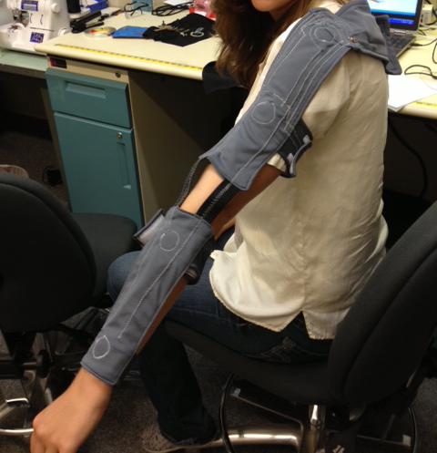
Contributions
Use a Bluetooth network as an activity monitoring system.
Allows the user to differentiate between activities such as sleeping, sitting, standing, walking, running, bike riding.
Can be used on top of an already existing Bluetooth networks.

Slide 7
Outline
Begin by creating a master/ slave Bluetooth architecture using a phone to be the master.
  In this case a phone can be used as the master with Bluetooth chips as the slaves.
Slave
Slave
Slave
Master
Slave
Slave
Slave
Slave

Slide 8
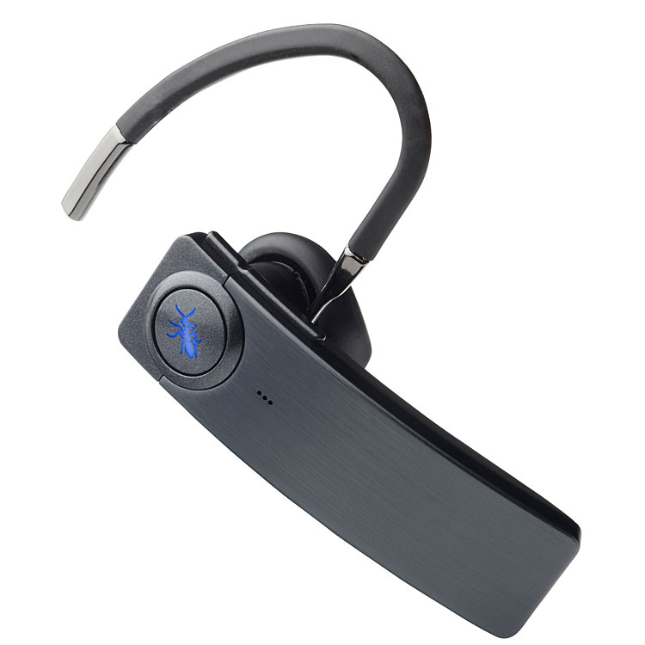
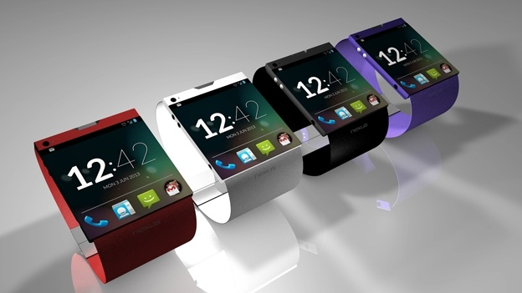
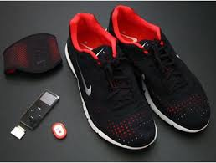
Outline
Gather data and analyze it to determine which activities are being performed.
  Test this to assure the activities are correct with the given data.
Once the system can distinguish between activities, test the battery usage and compare it to a system using an accelerometer and intermittent network connections to send the data to the base station.
Add the capabilities of using devices that already incorporate Bluetooth such as smart watches and Nike + shoes.

Slide 9
Questions,
Comments,
Suggestions?

